Slide 1
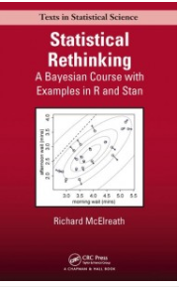

Statistical rethinking: applying Bayesian models in Stan

Slide 2
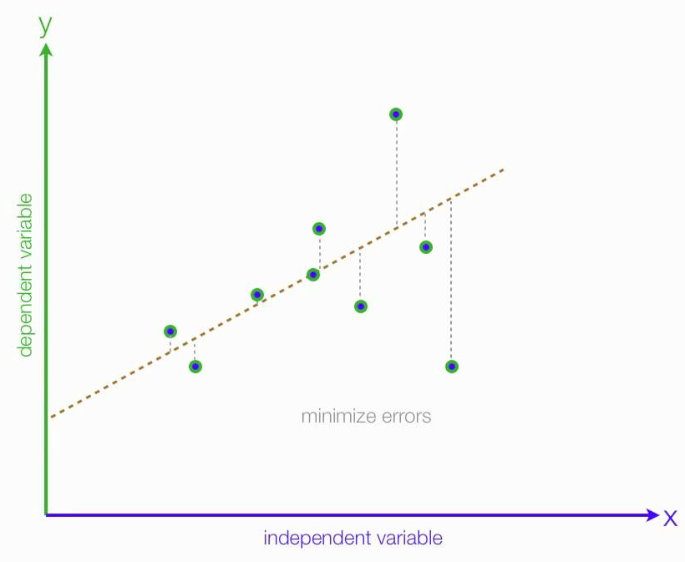
Different ways to make inference
Frequentist
Maximum likelihood
Bayesian
Sampling-Importance-Resampling (SIR)
Markov Chain Monte Carlo (MCMC)
Hamiltonian Monte Carlo (HMC)
No U-Turn Sampling (NUTS)
Bootstrapping (Monte Carlo)
Hybrid Bayesian and Frequentist
Likelihood profiling
Hybrid Bayesian and Frequentist

Slide 3
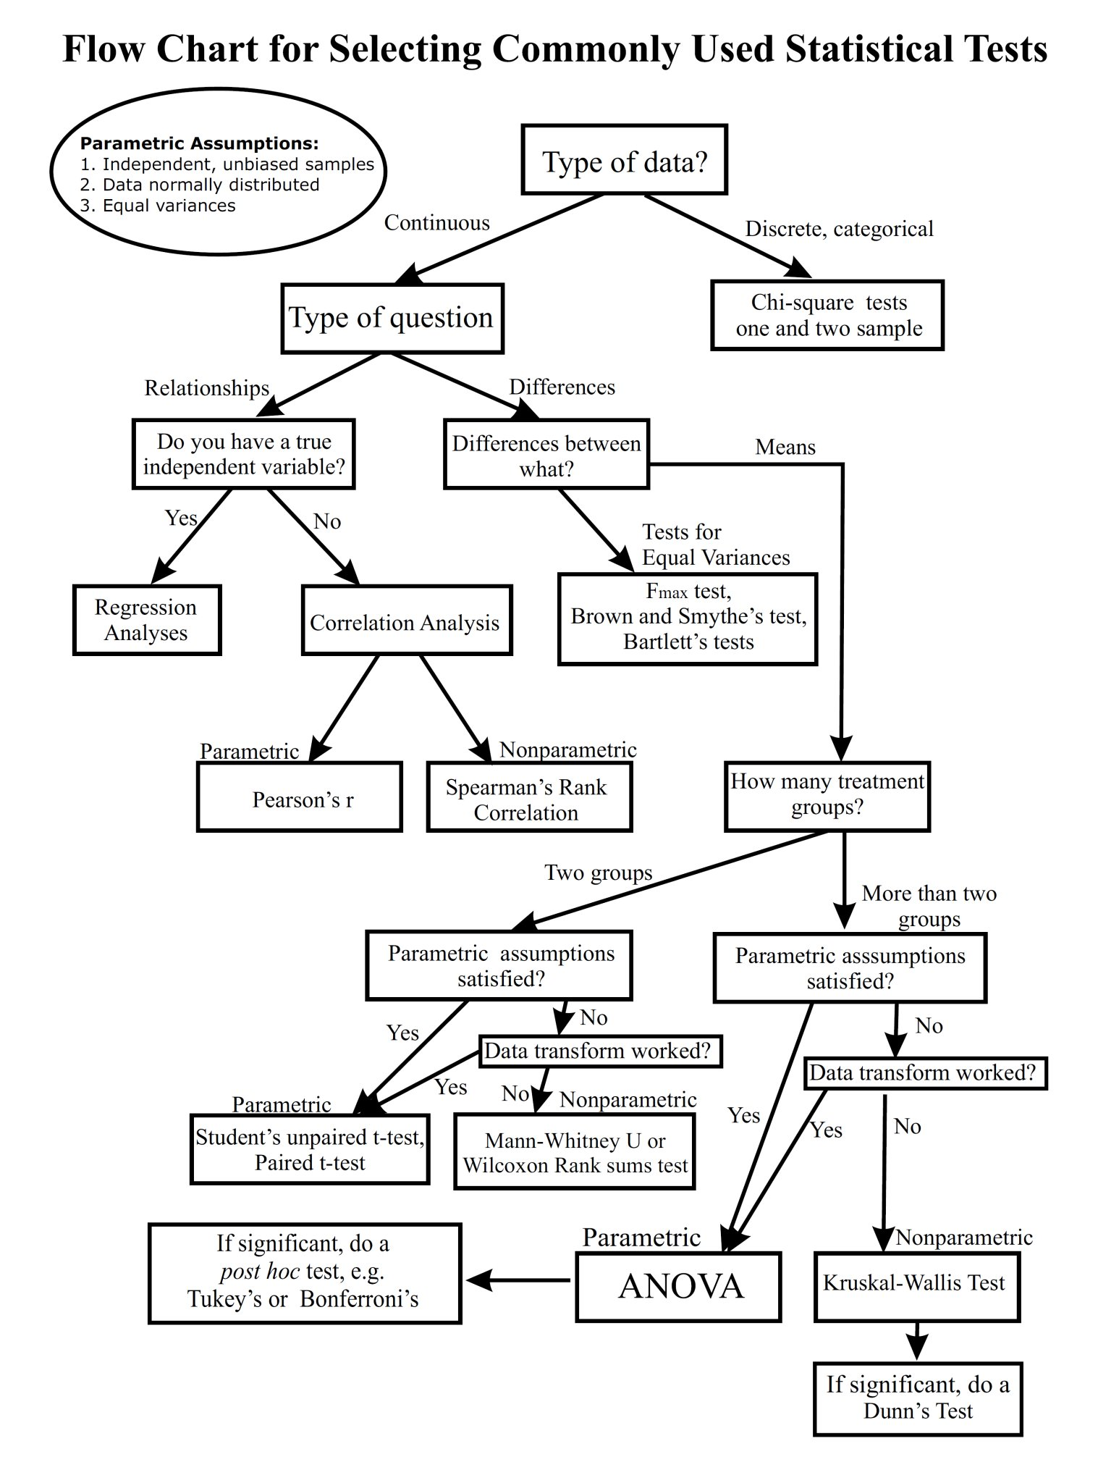
Frequentist:
In practice:
Choose your own adventure!
See which assumptions you can justify
Fit a statistical model
Hope you understand the test
Hope you cross a threshold of significance

Slide 4
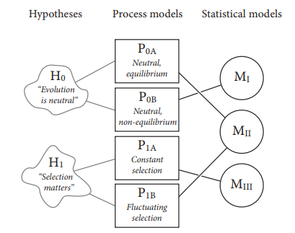
Statistical rethinking
If we learn the foundations we can:
Learn to be flexible on your model and distributions
How did our data arise from a process (or processes)?
Know how to code your own model
Defend our chosen assumptions
Understand the model
Avoid relying on a hope for significance

Slide 5
Frequentist v. Bayesian
Frequentist statistics:
Data are random
Model is known truth
Data arise from true model
Can know truth if we repeatedly sample new data
Decision rules on inference are sharp
x has significant, positive effect on y (p << 0.05)
x has insignificant effect on y (p > 0.05)
Bayesian paradigm:
Data is known truth
Model is random
Model parameters can be described probabilistically
Decision rules on inference are continuous
x has strong, positive effect on y (98% probability effect > 0)
x has uncertain effect on y (58% probability effect > 0)

Slide 6
Frequentist v. Bayesian
Both rely on log-likelihood functions L of data X and model M
Frequentist:
What is the likelihood of the data X given the model M?
Maximize log-likelihood of model M fit to data X
e.g., minimize sums of squared residuals
Run a test to determine if model test statistics are significant
Bayesian:
What is the probability of the M given X and our prior hypothesis of M?
Describe the log-posterior as the log-likelihood of model + log-likelihood of prior

Slide 7
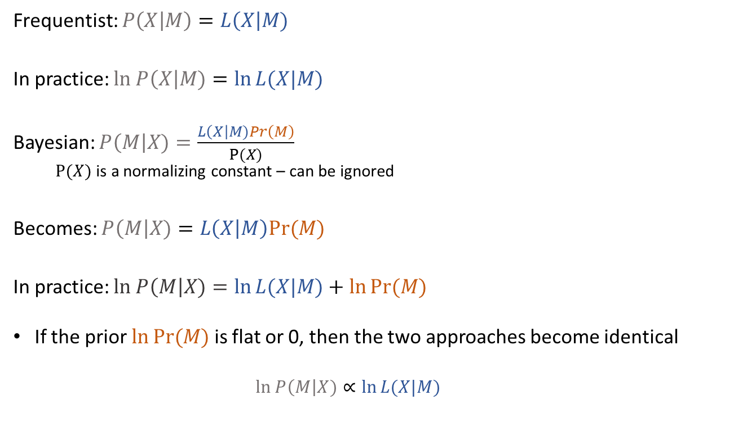
Frequentist v. Bayesian
Frequentist: $P\left(X | M\right)=L\left(X\right|M)$
In practice: $ln P\left(X\right|M)=\ln{L(X|M)}$
Bayesian: $P\left(M\right|X)=\frac{L\left(X\right|M)Pr\left(M\right)}{P(X)}$
$P(X)$ is a normalizing constant – can be ignored
Becomes: $P\left(M\right|X)=L\left(X | M\right)Pr⁡(M)$
In practice: $ln P\left(M\right|X)=\ln{L(X|M)}+\ln{Pr⁡(M)}$
If the prior $\ln{Pr⁡(M)}$ is flat or 0, then the two approaches become identical
$$ln P\left(M\right|X)∝\ln{L(X|M)}$$
Posterior
Likelihood
Prior
Bayesian
Frequentist

Slide 8
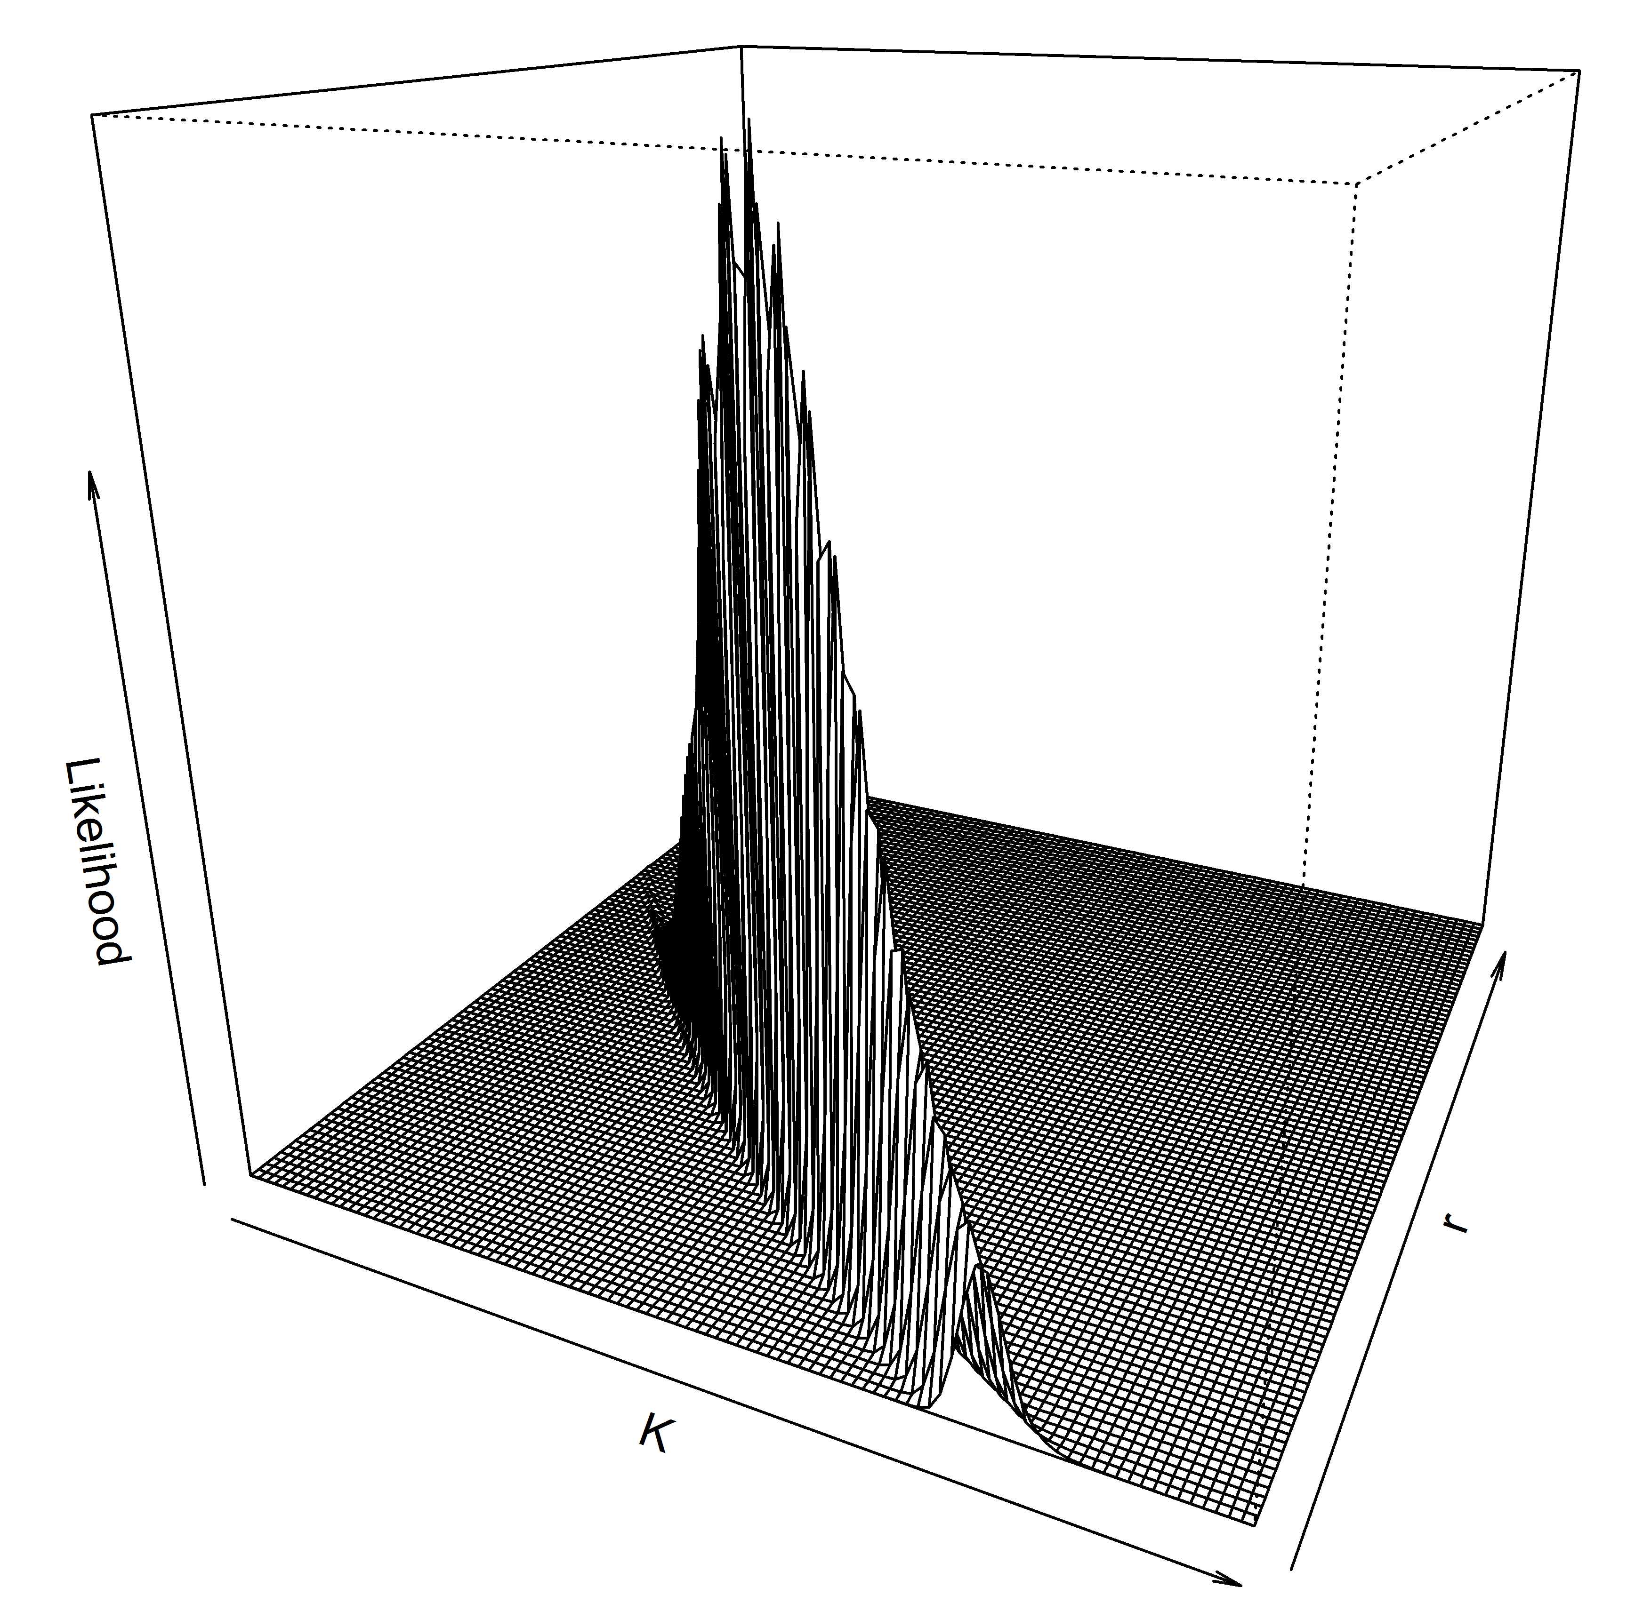
Example problem of two approaches: where is the truth?

Slide 9
Reasons to go Bayesian
Want to completely account for uncertainty in model and data
Want to make predictions or forecasts with uncertainty
Bayesian approaches often are best ways to account for uncertainty
Parameters estimated probabilistically rather than optimally
Parameters are correlated
Use posterior outcome to understand correlations
No single ‘most likely’ answer
Many ‘equally good’ combinations
Want to include prior data formally
Data-limited context
Hierarchical model
Multi-level models or meta-analyses

Slide 10
Problems of going Bayesian
Practical problems are mostly computation time and coding expertise
Posterior probability is difficult to compute
Interested in full description of uncertainty
Shades of truth
Find all combinations of model parameters
Describe probabilities of all combinations
Simple models:
Directly calculate posterior
Intermediate to complex models:
Posterior described by SIR algorithm
Becomes intensely slow with >5-10 parameters
Posterior described by MCMC and relatives

Slide 11
Why Stan?
Stan is a fast, flexible software to code your own models
Helps us surmount the practical problems of going Bayesian
Quickly describes posterior (or likelihood)
Users define likelihood/probability functions to do:
Maximum likelihood
Markov Chain Monte Carlo (MCMC)
Hamiltonian Monte Carlo (HMC)
No U-Turn Sampling (NUTS)
http://elevanth.org/blog/2017/11/28/build-a-better-markov-chain/

Slide 12
Goal of course
Three main practical goals
How do we operationalize a statistical model?
Turn a hypothesis into a process model into a statistical model
How do we code that model in Stan and fit this model to data
Includes deciding on software and MCMC algorithm
How do we interact with those results to draw meaningful inference

Slide 13
Style of course
Three main tasks each week:
Read the chapters/materials before class
Watch the YouTube lecture in class
Follow code & examples from chapter led by another person in class
Leader for week – prep material ahead of time and send out any relevant new code

Slide 14
MCMC – the goal
We use Markov Chain Monte Carlo to explore and describe the ‘mountain’ that is the posterior probability
To trust a posterior, the MCMC chains need to converge on a stable distribution
No autocorrelation in chain
Different chains reach the same distribution
An arbitrary midway point of the chain should be statistically drawn from the same distribution as the end of the chain

Slide 15
MCMC: how does it work?
Start at an initial vector of parameter estimates
Calculate log posterior density
Jump (using a jump algorithm) to a new vector
Random (or non-random?) jump away from current vector
Calculate posterior density of new vector
Stay at the new vector and proceed onward:
If new vector has higher posterior density or
At a probability based on the ratio of the new to the initial posterior density
Repeat

Slide 16
Visualizing MCMC cycle
r=2.49;
Accept the new point.

Slide 17
Visualizing MCMC cycle
r=0.5;
Accept the new point
with probability 0.5

Slide 18
MCMC: how does it work?
Starting vector
First “few” points

Slide 19
The jump function algorithm
Best if it is efficient
Don’t jump to areas you already explored
Don’t jump to areas that have 0 probability
Some much more efficient than others
Hamiltonian (HMC) more efficient because it is not a random-walk
Determines software choice
BUGS & JAGS use Gibbs-sampling for conjugate priors
JAGS uses AR Metropolis for non-conjugate
Conditional updating parameters one-by-one
SLOWWWWW, but very stable
ADMB & TMB
Uses Metropolis but can include mixture (TMB now has Hamiltonian)
STAN
Uses Hamiltonian
http://elevanth.org/blog/2017/11/28/build-a-better-markov-chain/

Slide 20
Bayesian in practice
Posterior = Prior + Likelihood
Probability densities in log-space
Prior must be specified as a distribution
e.g., dnorm() with a mean of x, and an sd of y
Likelihood is a distribution as well
Software choice dictates how this can be implemented
JAGS/BUGS doesn’t allow for customized likelihoods
No way to simply do sums-of-squares

Slide 21
MCMC – the diagnostics
Determining convergence is art, not science
Do not use only one test
All available in the {coda} library package
Geweke test
Gelman-Rubin test
Currently most preferred
Heidelberger-Welch test
Autocorrelation test
Raftery-Lewis test
Effective sample size test
N posterior samples
Autocorrelation means you have M independent samples
Is M << N ?
Bad MCMC

Slide 22
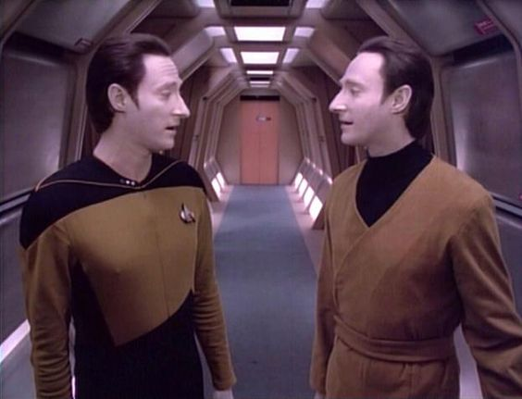
Bayesian in practice
Do you have
Good Data or Bad Data?
Choice of prior has important consequences on inference
Informative prior is good and bad
Good: you have a previous idea of what to expect
Bad: the prior might become your outcome (posterior)
Uninformative prior is good and bad
Good: you let your data do the talking
Bad: your data sucks and tells you to jump off a cliff

Slide 23
Bayesian in practice
Choice of prior has important consequences on inference
Uniform priors says that across a range of x to y, all outcomes are equally likely
Good if we want this
Bad because it might make computations slower than they need to be
Binomial event: 0 or 1
Event occurs with probability p
p is bounded between 0 and 1
p ~ dunif(0,1) ?
p ~ dbeta(0.001, 0.001) ?
More informative than dunif()
Still not very informative at all
Haldane prior

Slide 24
Bayesian hypothesis testing and model comparisons
Look at amount of posterior mass above or below certain thresholds
Simply look at 95% credible intervals for the coefficient of interest
Do the intervals cross 0?
Bayesian p-values
Bayes Factor
Good for null hypothesis testing
Not easy to implement for most complex models
Easy enough for regressions
DIC & information criteria
Analogue to AIC
Posterior predictive checks
Leave-one-out cross validation

